Slide 1

VAE on MNIST - Gradient Clipping

Slide 2
Reference
Miriam’s Blogs one, two, and Code on VAE
Youtube
Code

Slide 3
Warm Up

Slide 4
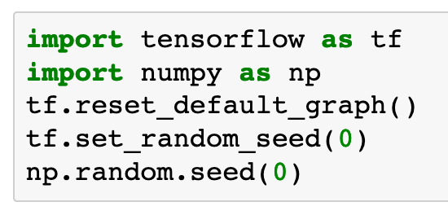

Slide 5
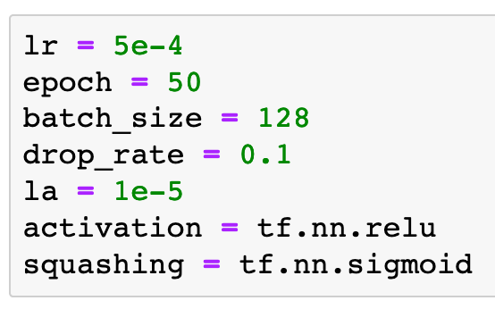

Slide 6
Make Directories

Slide 7
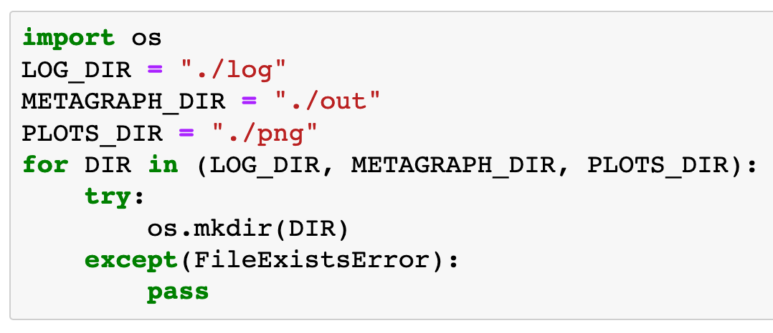

Slide 8
Data

Slide 9
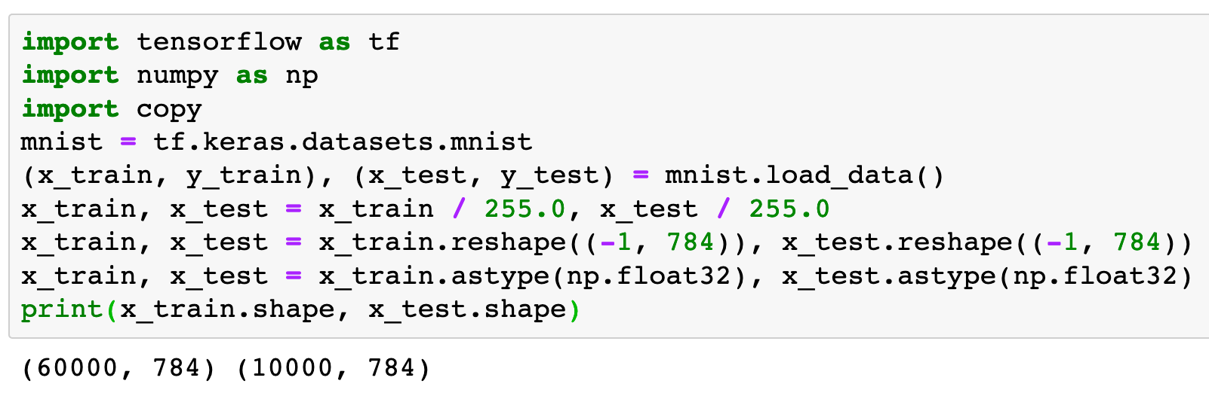

Slide 10
Graph

Slide 11
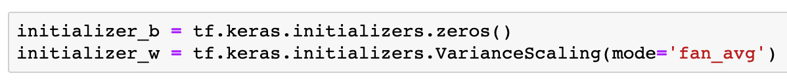

Slide 12
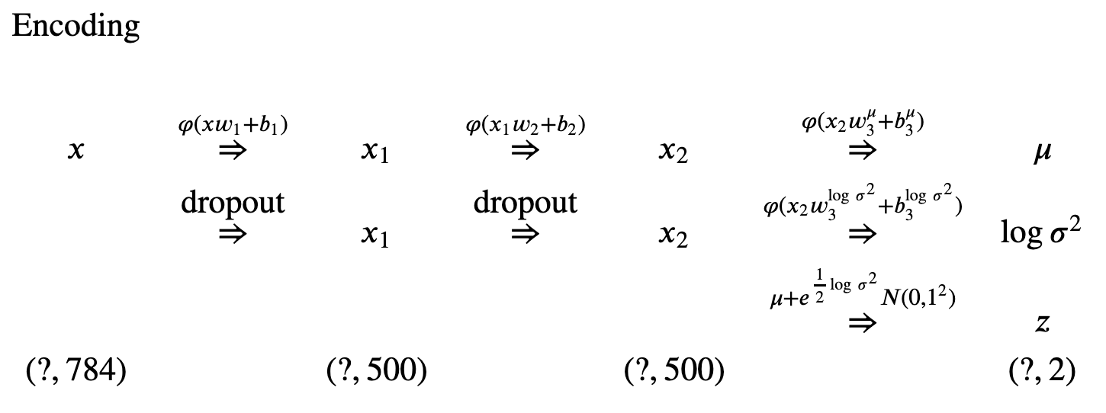

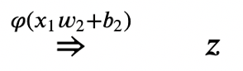

Slide 13
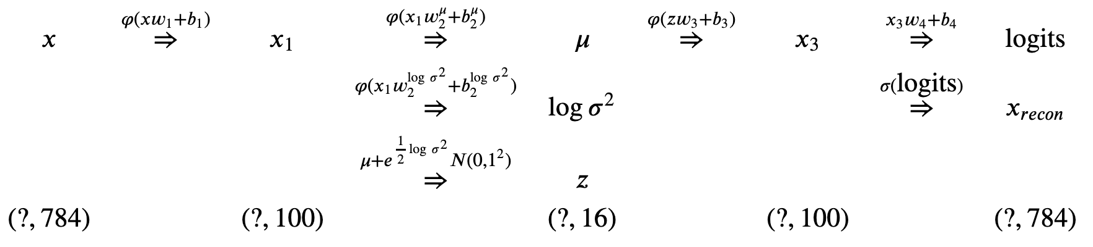
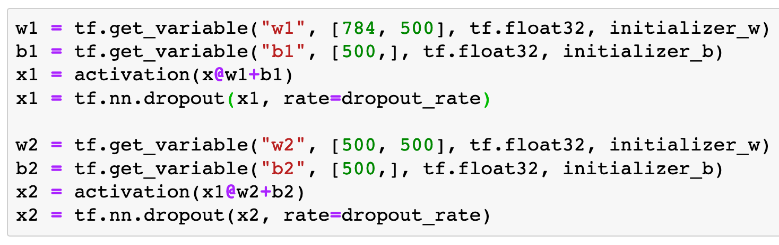

Slide 14
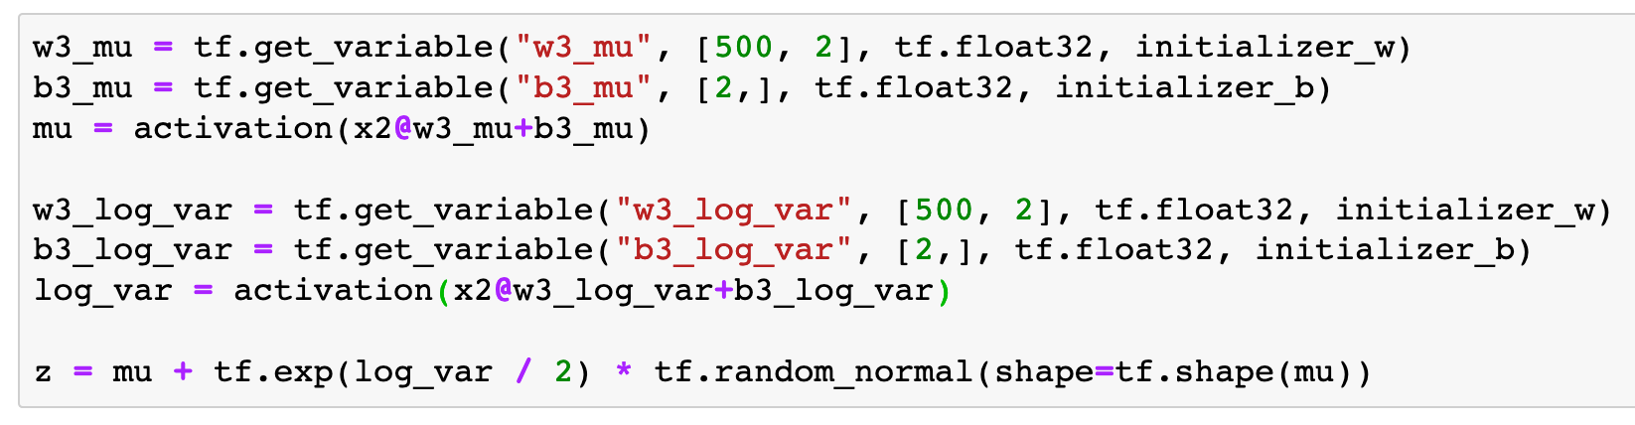
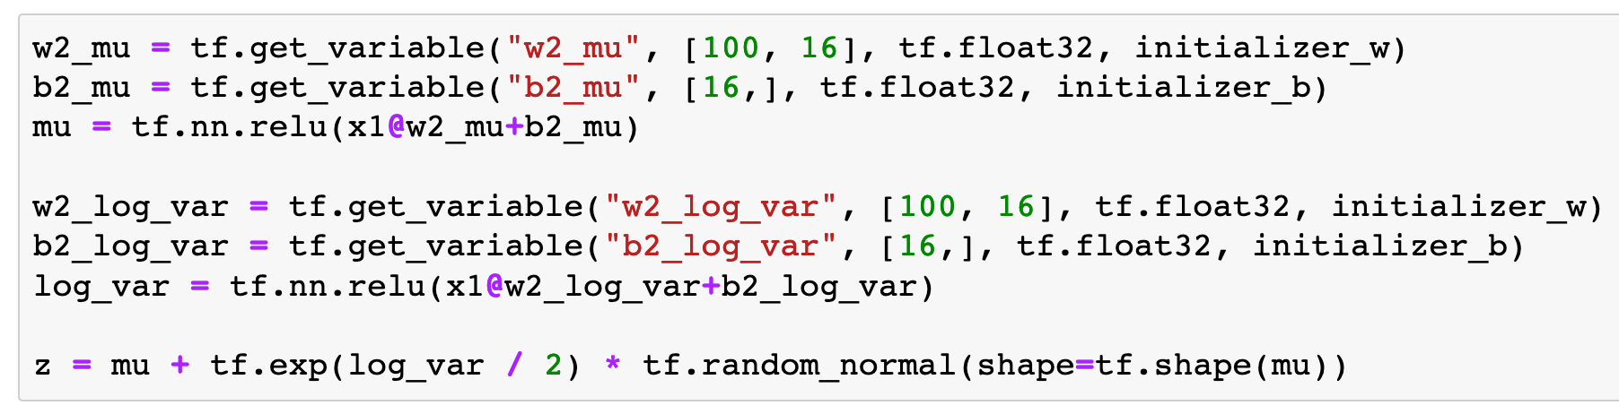
VAE

Slide 15
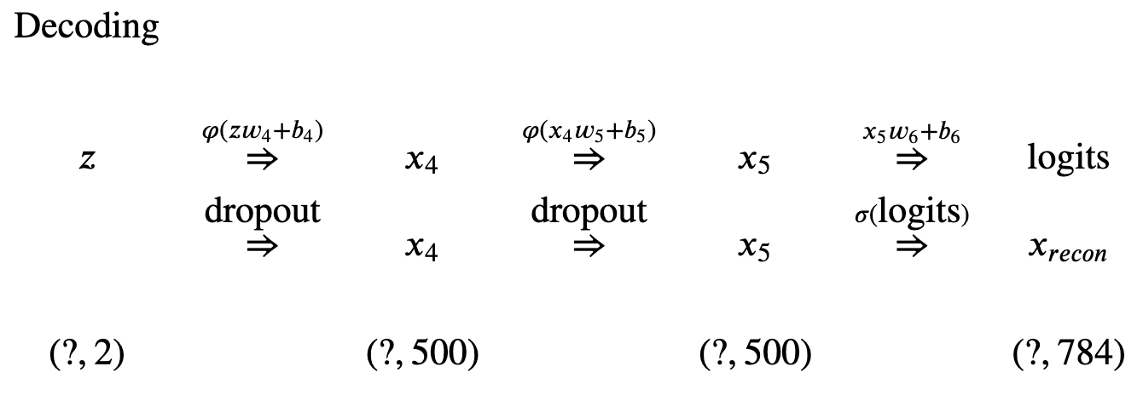
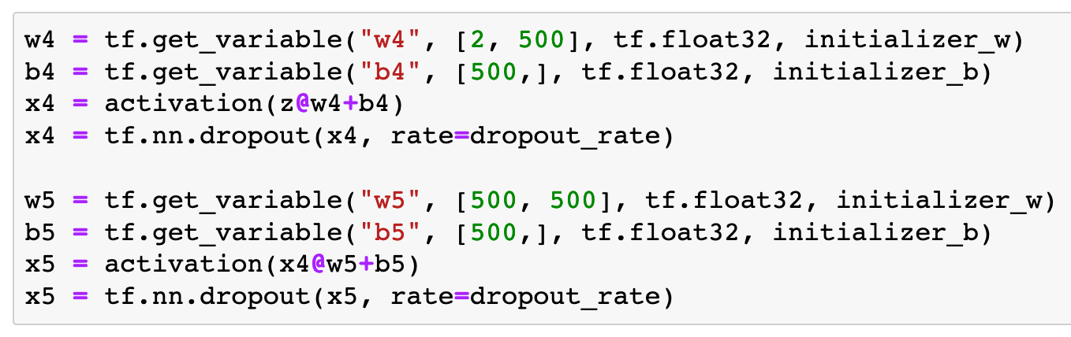
VAE

Slide 16
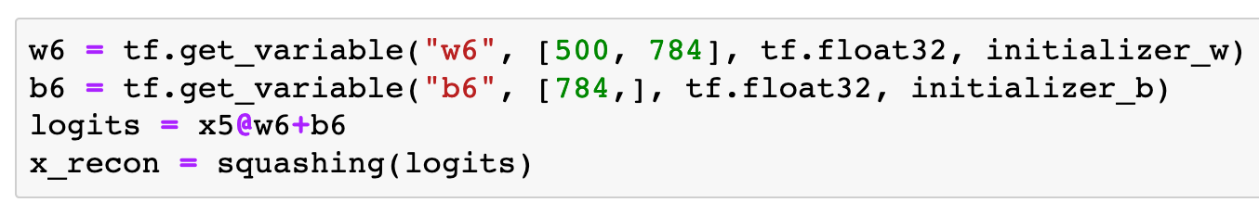

Slide 17
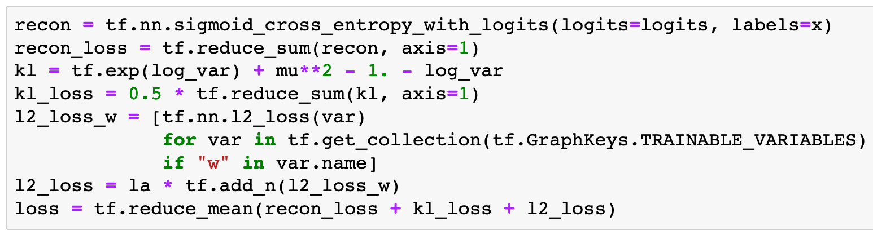

Slide 18
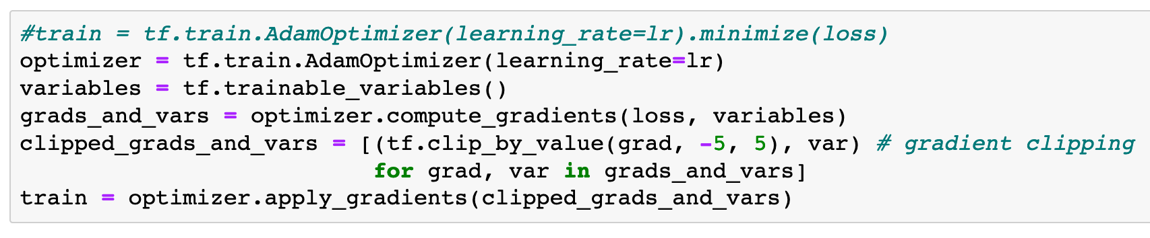
Gradient Clipping

Slide 19
Session

Slide 20
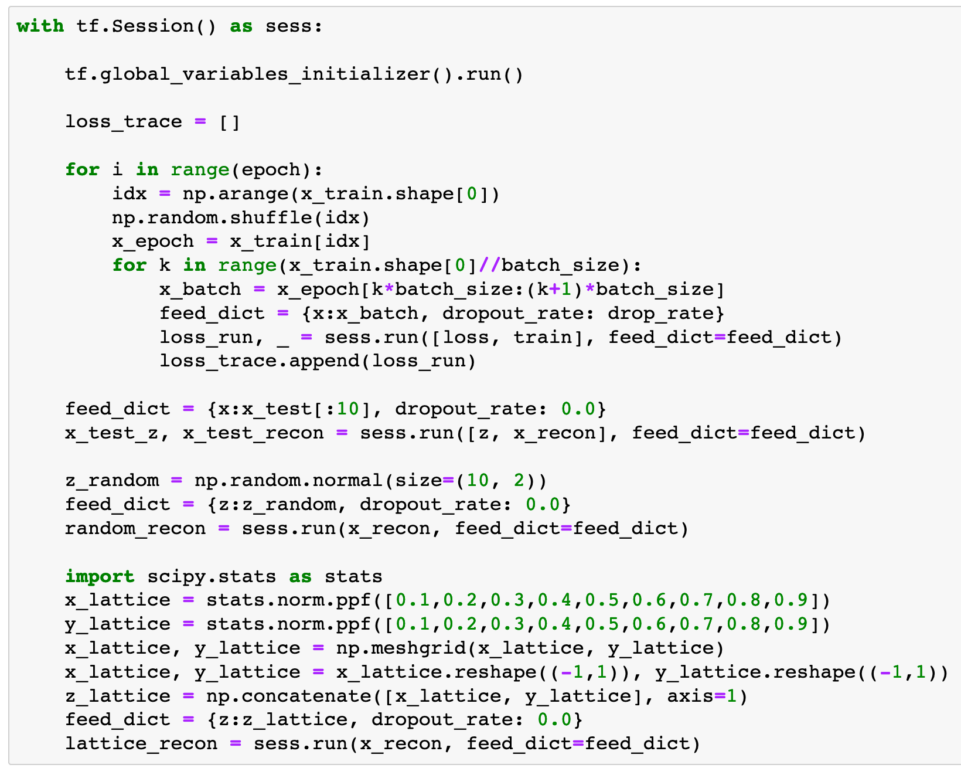

Slide 21
Report Result

Slide 22
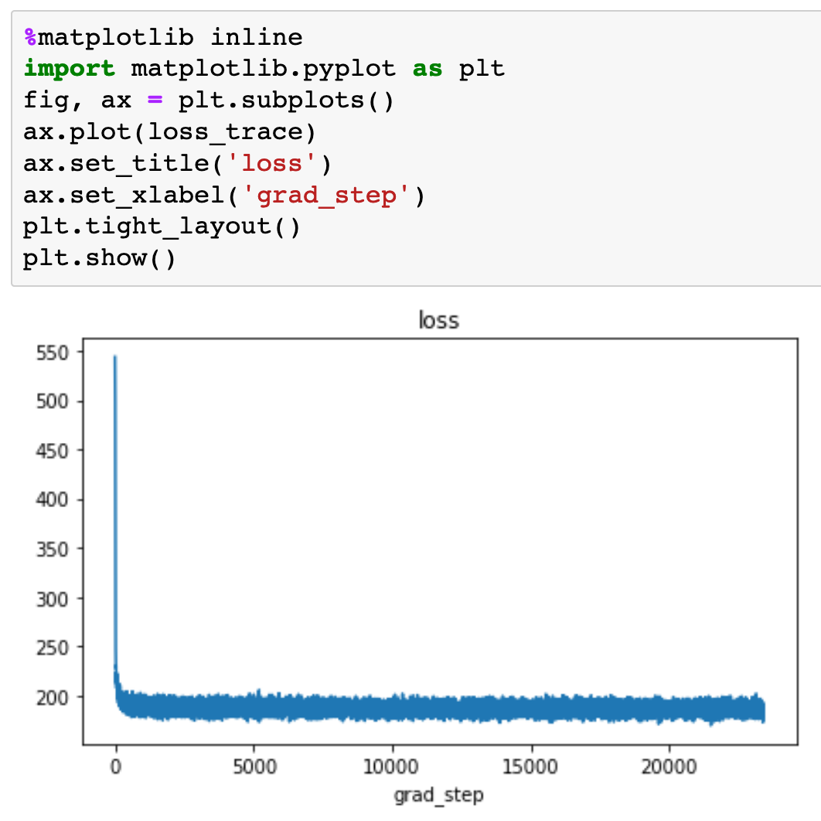

Slide 23
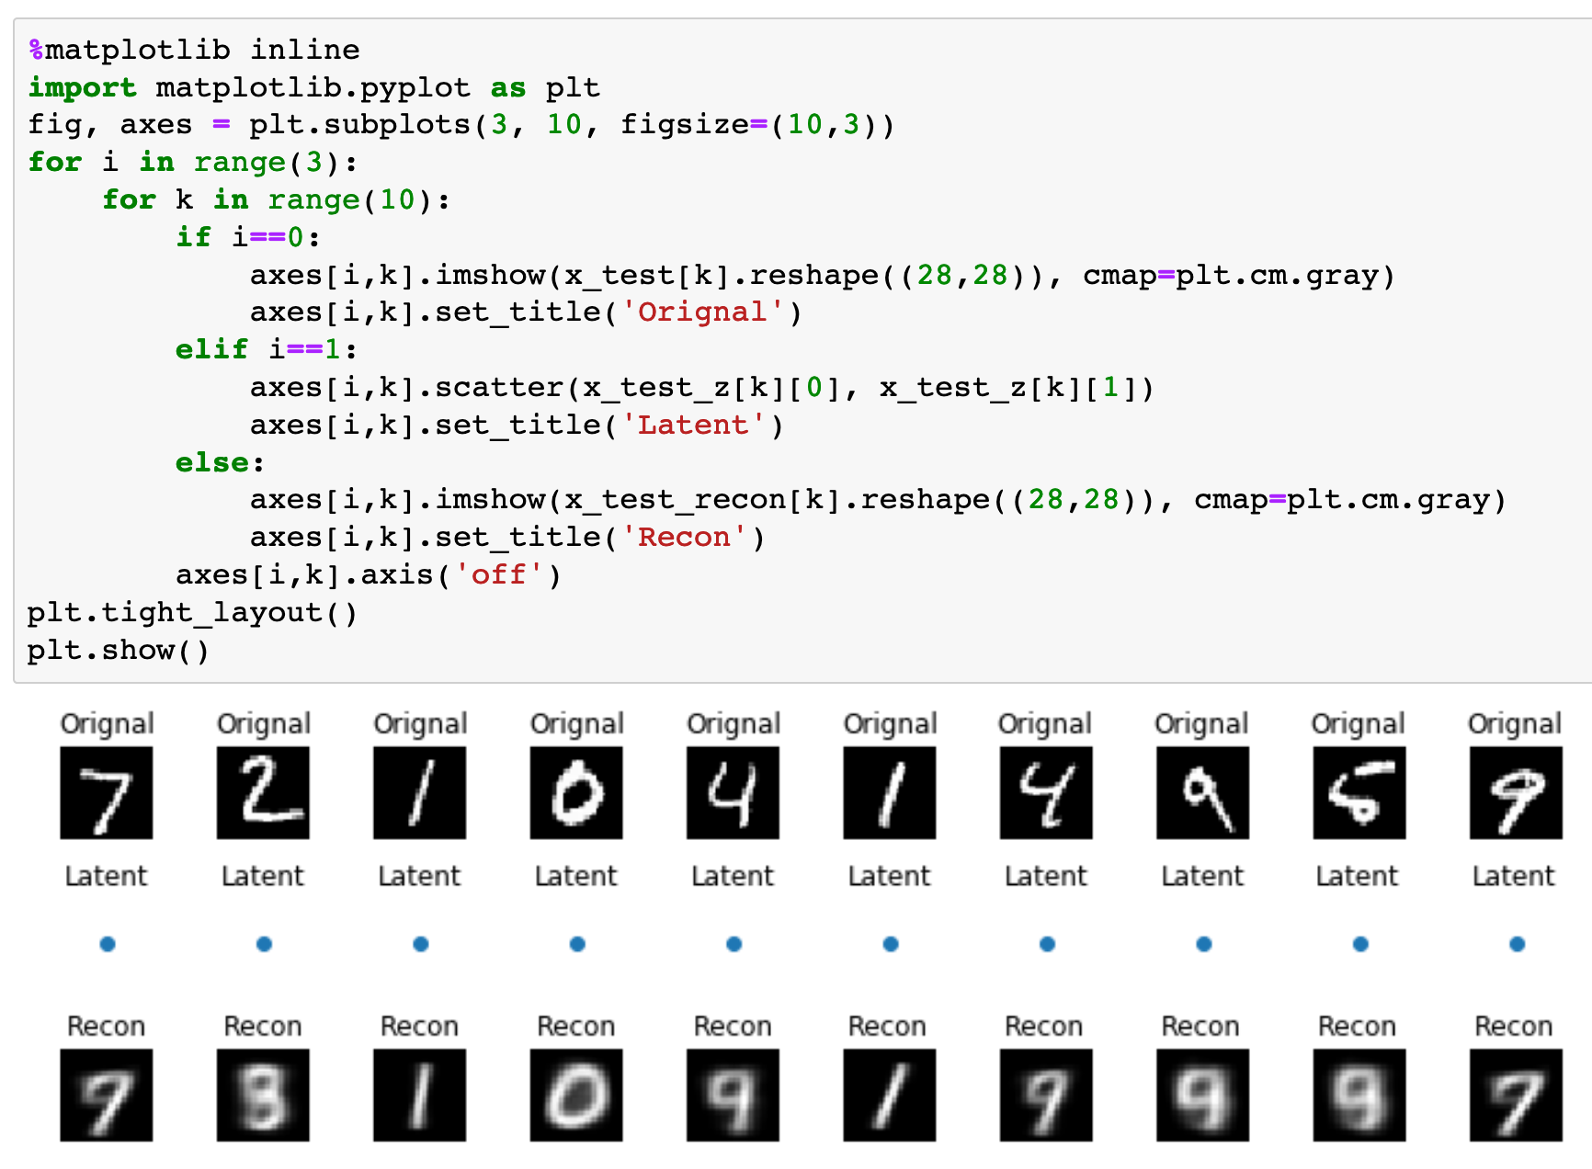

Slide 24
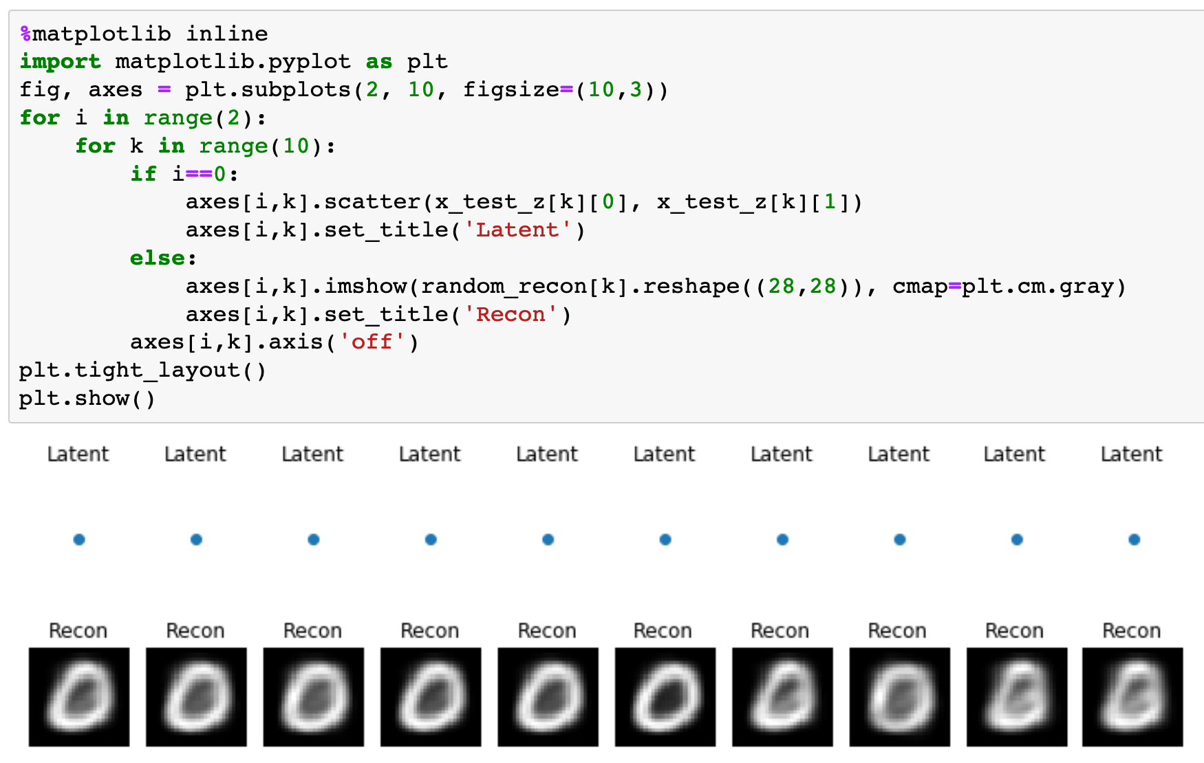

Slide 25
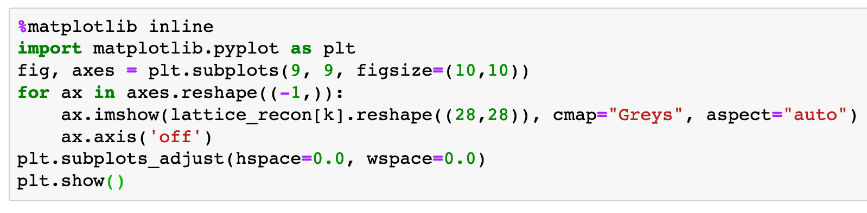

Slide 26


Slide 27
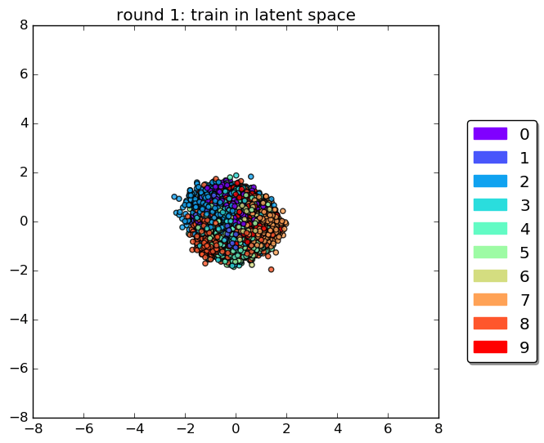
Exercise. Reproduce the following beautiful latent space walk.
Miriam’s Blogs one on VAE

Slide 28
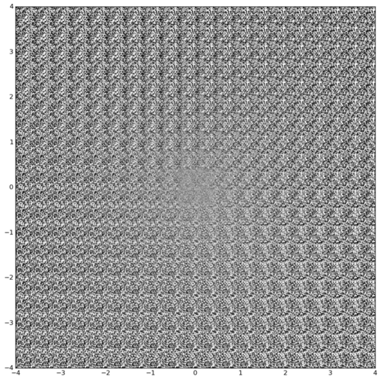
Exercise. Reproduce the following beautiful latent space walk.
Miriam’s Blogs one on VAE

Slide 29
Now
Let’s Play with Code

